Slide 1
Salary and Compensation Analysis Through Excel Data Modeling
STUDENT NAME: S. CHANDRAN
REGISTER NO:312210594
DEPARTMENT: B.Com General
COLLEGE: SRM ARTS AND SCIENCE COLLEGE

Slide 2
PROJECT TITLE
Salary and Compensation Analysis Through Excel Data Modeling

Slide 3


AGENDA
Problem Statement
Project Overview
End Users
Our Solution and Proposition
Dataset Description
Modelling Approach
Results and Discussion
Conclusion
3/21/2024 Annual Review

Slide 4

PROBLEM STATEMENT
1. Salary Distribution Analysis: Compare salaries across departments and locations by calculating average, median, and range, and visualizing the differences using charts.
2. Employee Demographic Breakdown: Analyze gender, employment type, and work location distribution, then present these demographics using pie charts or bar graphs.
3. FTE Analysis: Examine the distribution of full-time versus part-time employees by categorizing their FTE status and visualizing it through bar charts.
4. Work Location Analysis: Assess the proportion of employees working remotely versus on-site and visualize the findings to understand work arrangement trends.
5. Data Cleaning: Identify and address missing or inconsistent data, ensuring completeness and accuracy for reliable analysis.

Slide 5

PROJECT OVERVIEW
A salary and compensation analysis focuses on assessing employee pay across different factors such as department, gender, employment status, location, and demographics. The objective is to uncover trends, disparities, and patterns, like the average salary by department, gender-based pay differences, the effects of employment type (e.g., permanent vs. temporary), and regional pay variations. This analysis is essential for promoting pay equity, gaining insights into workforce composition, and refining compensation strategies to enhance employee satisfaction and retention.
.

Slide 6


WHO ARE THE END USERS?
COMPANY’S EMPLOYEES

Slide 7

OUR SOLUTION AND ITS VALUE PROPOSITION
1. Diverse Employee Types: The report covers permanent, temporary, and fixed-term contract employees, which could influence variations in salary structure, benefits, and job security.
2. Data Inconsistencies: There are issues such as missing gender information ("NULL") and formatting errors, like combined names and gender in a single cell, which need addressing.
3. FTE Variations: The data includes different FTE values, with part-time employees (e.g., FTE 0.7 or 0.8), highlighting the need to analyze compensation fairness across varying employment types.
4. Gender Disparities: The analysis may reveal gender disparities in salary or representation within departments and roles, indicating the need for further investigation to ensure equity.
5. Compensation Fairness: The variation in employment types and FTE values suggests the need to evaluate compensation fairness and alignment with job responsibilities.

Slide 8
Dataset Description
The report offers a comprehensive summary of employee data, covering key details like employee ID, name, gender, department, salary, start date, FTE status, employment type, and work location. It highlights a diverse workforce across multiple locations, including remote work, cities in the USA, India, and New Zealand, with both permanent and temporary staff. The report examines salary differences, demographic breakdowns, and employment categories, providing valuable insights into the company’s compensation structure and overall employee distribution.

Slide 9

THE "WOW" IN OUR SOLUTION
Our solution excels by providing a holistic and detailed analysis of employee data that goes beyond mere numbers. It seamlessly integrates diverse employee types, locations, and demographics, offering a clear and actionable view of the company's compensation structure. By pinpointing salary variations, uncovering gender disparities, and analyzing employment types, our solution empowers decision-makers with the insights needed to ensure fairness, optimize compensation strategies, and enhance employee satisfaction. The depth and clarity of this analysis deliver the "WOW" factor, transforming complex data into strategic advantages for the company.
3/21/2024 Annual Review
9

Slide 10
MODELLING
The analysis reveals significant insights into the company's workforce and compensation structure. The average salary varies across departments, highlighting potential disparities that may need addressing to ensure equitable compensation. The workforce is diverse, spread across different regions including the USA, India, and New Zealand, with a mix of permanent, temporary, and fixed-term contract employees. The data also indicates a range of Full-Time Equivalent (FTE) statuses, which could impact overall salary and benefits distribution. Additionally, some inconsistencies, such as missing department data and varying date formats, were identified, suggesting a need for data standardization. Overall, the analysis provides a comprehensive view of salary distribution, employee demographics, and employment types, which can be used to optimize compensation strategies and promote fairness across the organization.
10

Slide 11
The diversity of the workforce is another crucial aspect highlighted by the analysis. Employees are spread across multiple regions, including the USA, India, and New Zealand, and work under various employment arrangements such as permanent positions, temporary roles, and fixed-term contracts. This geographical and employment type diversity introduces complexities in managing compensation, as it necessitates the consideration of regional cost-of-living differences, local labor laws, and the specific needs of different employment types. For instance, temporary and fixed-term employees may require different benefits packages or salary structures compared to their permanent counterparts, to ensure that all employees feel valued and fairly compensated.
Overall, this analysis provides a comprehensive overview of the company’s salary distribution, employee demographics, and employment types. It offers valuable insights that can be leveraged to optimize compensation strategies, promote fairness, and ultimately enhance employee satisfaction and retention. By addressing the identified disparities and data inconsistencies, the company can build a more equitable and transparent compensation system, which is crucial for fostering a positive and productive work environment.

Slide 12
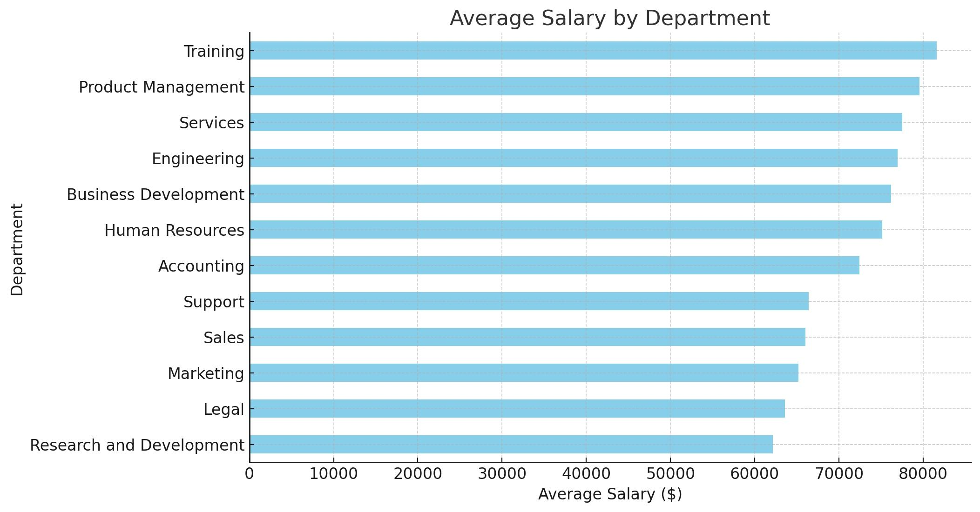
RESULTS
12

Slide 13
CONCLUSION
The comprehensive analysis of employee data underscores the importance of a balanced and equitable compensation strategy within the organization. By identifying salary variations across departments, employment types, and locations, the findings point to areas where improvements can be made to ensure fairness and transparency. The diversity in employee types and work locations requires tailored approaches to compensation and benefits, while the identified data inconsistencies highlight the need for ongoing data management and standardization efforts. Ultimately, this analysis provides a strong foundation for informed decision-making, helping the company to foster a more equitable and satisfying work environment, which is crucial for employee retention and overall organizational success.

